Slide 1
Functions

Slide 2
Reusing Code (Why write it twice?)
Generally bad to copy and paste code
Can cause errors
Takes up extra space
Hard to read
Can we do better?

Slide 3
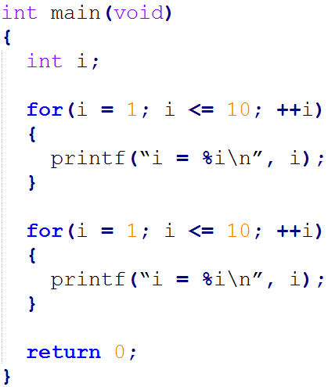
Simple Code Duplication

Slide 4
Enter Functions
Allow us to reuse code and make it more flexible
Consist of 4 things:
Function name – Must be a unique identifier
Parameters – Data you give to the function
Return Type – Type of data you get back from the function
Function Body – The code to get executed
These four things are called a function definition
Just like variables, functions must be defined before they are used!

Slide 5
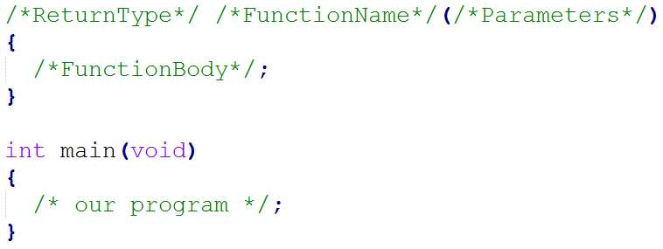
Function Format

Slide 6

Simplest Function (Bonus: A new keyword!)
A new keyword: void means nothing!
A function called my_function. We give it nothing, we get back nothing, and it does nothing

Slide 7
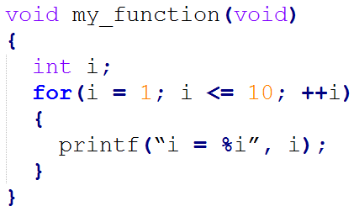
A Bit More Complicated
What do we give to this function?
What do we get back?
What does the function do?

Slide 8
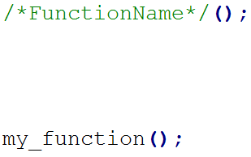
Using A Function
When you use a function, we say you called the function
A function with no parameters is used like this:
Our simple function:

Slide 9

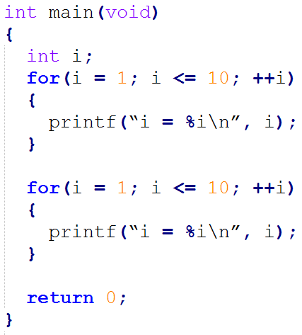
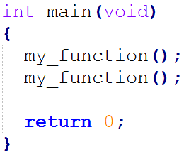


Using Our Simple Function

Slide 10

Parameters
Data for our function to use
Lets the function have the same logic, but different data
Can be used like regular variable in our function
Data is copied!
Parameters

Slide 11
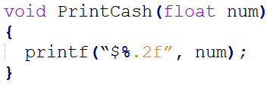
Function With Parameters
How would we describe this function?
What is the function called?
What do we give it when we call it?
What does it return to us when we call it?
What does this function do?
What is the scope of num?

Slide 12
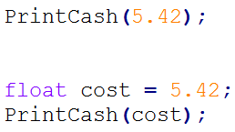
Using A Function With Parameters
Giving data to a function is called passing the data
Our PrintCash function:
or

Slide 13
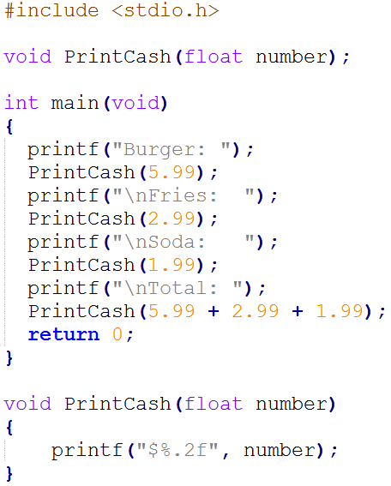

A Full Example
Output:

Slide 14
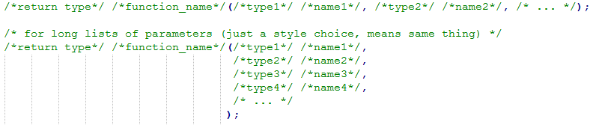
What If It Needs More Data?
Can have more than one parameter
Each parameter has a type and a name
Each parameter is separated by a comma
No maximum number of parameters

Slide 15
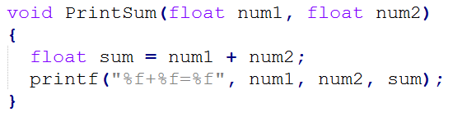
Two Parameter Example
A function called what, we give it what, and it gives us back what?
What does this function do?

Slide 16
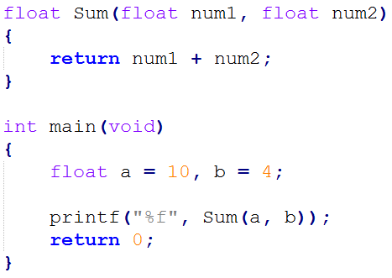
Return Type
Sometimes we want to get data back from the function
Return type says two things:
Are we getting data back – type is void if no
What type of data we're getting back

Slide 17
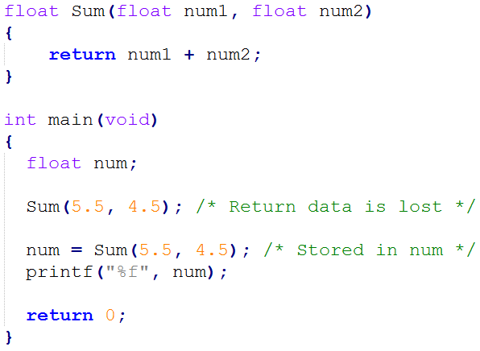
Example

Slide 18
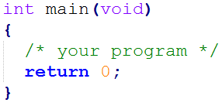
Another Look At main
A function called what, what is it given, what does it give back?
Why do we need to return 0?

Slide 19
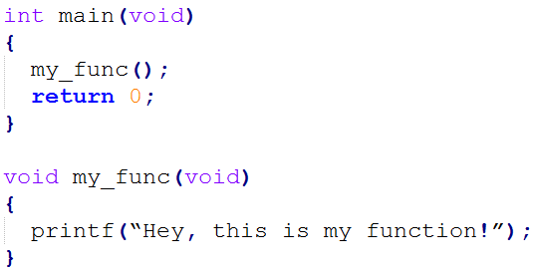
Defined After Using?

Slide 20
Prototypes
Compiler must know a few things about a function before it's used:
Function name
Parameters
Return type
Compiler Doesn't need to know about the body
Linker needs to know about the body

Slide 21
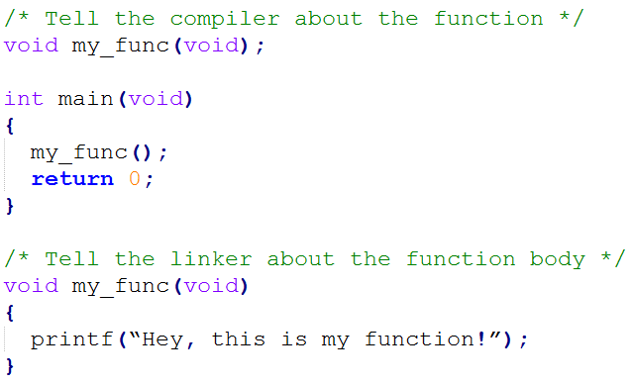
Try Again With Prototypes

Slide 22
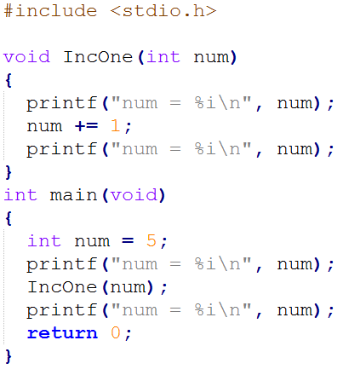

What does this print?
Output:
Our programs pass data by copy
Functions get a copy of the data
Original doesn't change
To change the original, use a return value!

